Slide 1
The author publishing journey
Rightslink OA Agreement Manager
Post sales support
Contact details

Slide 2
Open Access Publishing Workflow
Prepare manuscript
Submit manuscript
Text
Peer
review
Publication decision
APC
transaction
Article production
Article publication
Text
Text
All articles submitted to Cambridge University Press undergo the same rigorous peer-review to sustain the high quality of our journals.
The decision to publish an article is not affected by whether it will be published Open or behind a paywall.

Slide 3
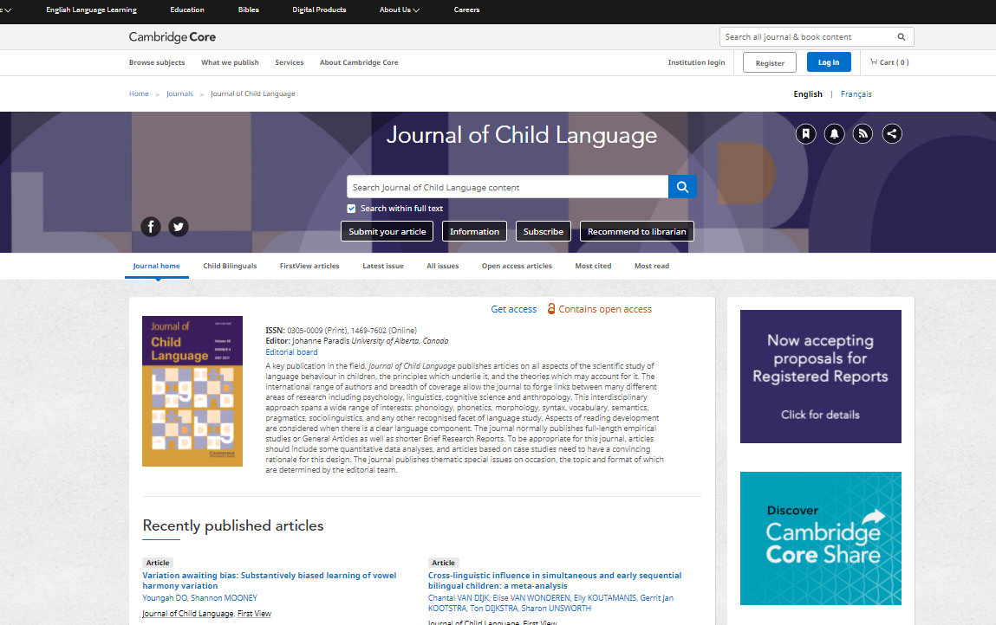
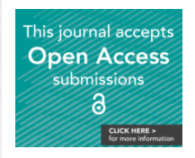
Journal homepages
Information on manuscript preparation is available on the journal’s homepage on Cambridge Core.
Open Access information is signposted on these pages.
Pop ups appear on relevant gold OA and hybrid journal pages to invite authors to check their eligibility for an APC waiver / discount using our checker tool.

Slide 4
Submit manuscript
The submission system – aka Online Peer Review System – can be accessed from the journal’s homepage on Cambridge Core.

Slide 5
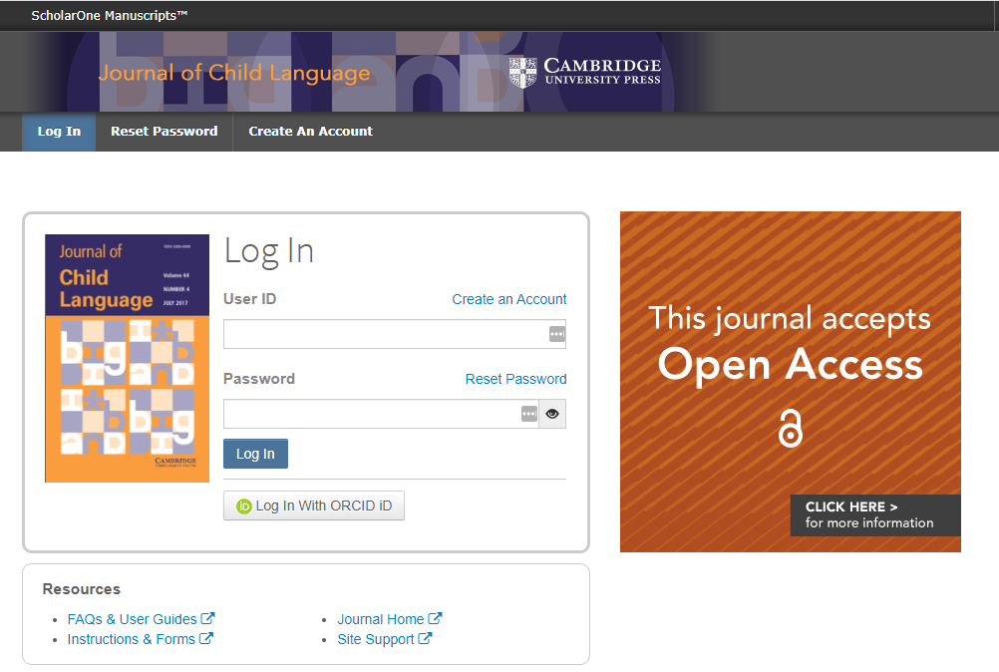
To submit:
Log in, using either a username and password or ORCID.
During this process, identify the corresponding author whose affiliation is used to determine eligibility.

Slide 6
Peer review
Ensures submitted article is suitable for journal
Ensures article is sound and accurate
Alerts to errors
Provides constructive feedback
Possible outcomes:
Accepted without any change
Revise and resubmit
Paper rejected
Manuscript then proceeds through editorial and peer review

Slide 7
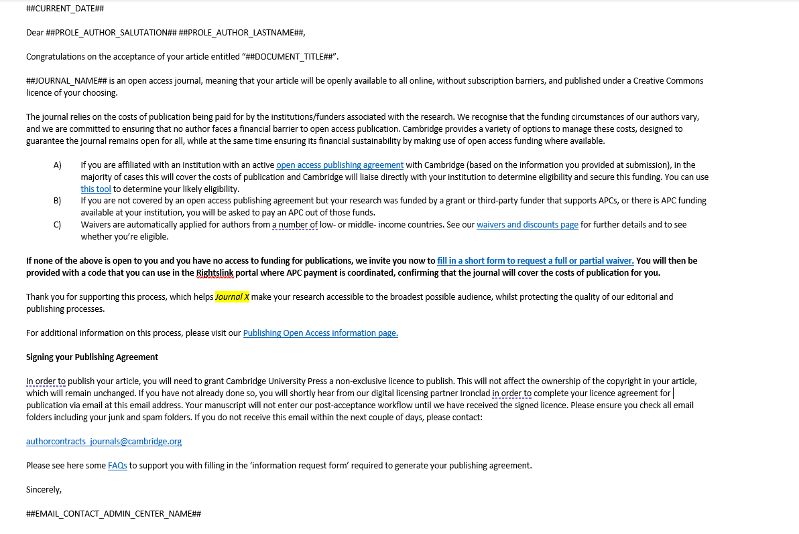
Acceptance
If an article is accepted, following the completion of any revisions required, authors will receive an acceptance email.
Notes:
This email is for Research Open *and* Gold OA, post-acceptance waiver, 3RBC.

Slide 8
Acceptance
Receive email with link to complete author publishing agreement (license to publish form)
Complete Open Access agreement, select a creative commons licence and return to Content Manager (production contact)
Record created in production tracking system

Slide 9
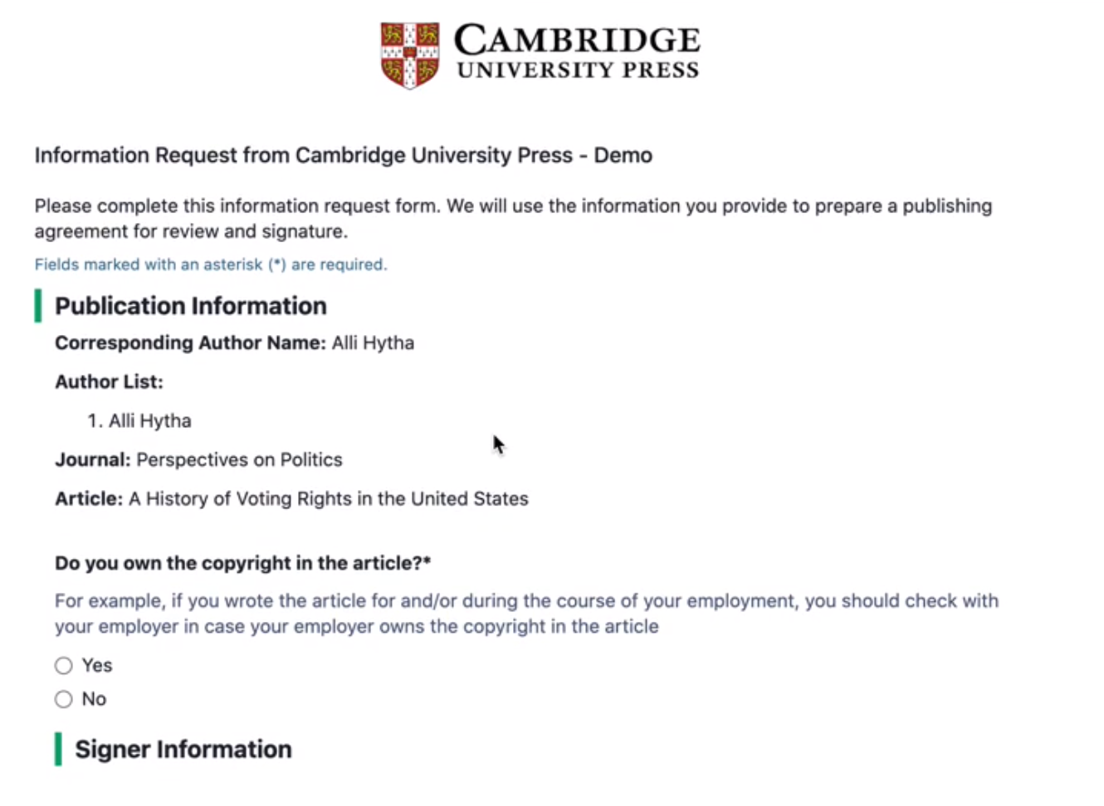
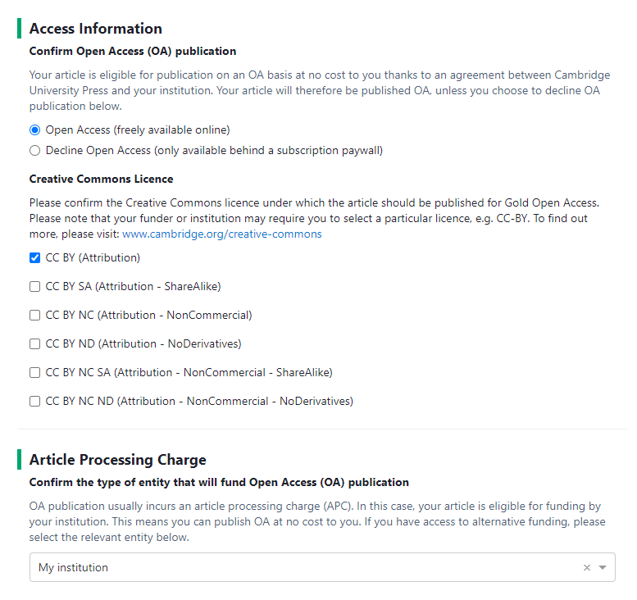
Improved digital licensing solution
Receive an information request form from Ironclad, pre-populated with information from submission system
Open Access publication and CC-BY are preselected.
Specific messaging to authors recognized as eligible under an institutional Open Access agreement.
Contract generated automatically and signature signed digitally
284 titles currently live

Slide 10
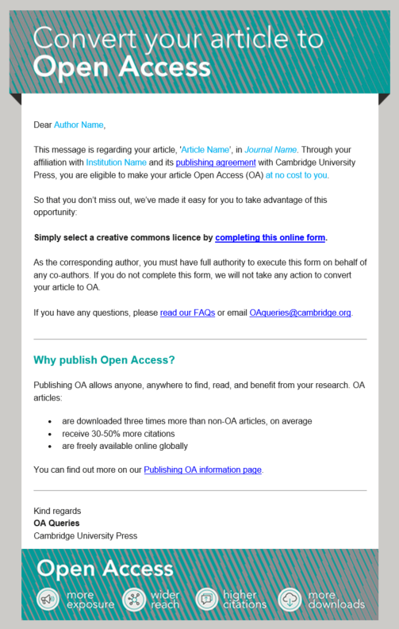
Retroactive OA
Authors who do not select the OA option and are identified as eligible under an agreement are informed of the opportunity via. a monthly outreach campaign.
A simple online form allow authors to select their creative commons licence. This form functions as an addendum to any existing agreement.
If a contract has been processed on Ironclad, authors will amend their original agreement.

Slide 11
Touch Free Transactions
Author signs contract
Production record updated
Article sent to Rightslink®
Funding approved*
Transaction complete
Affiliated authors of eligible articles do not interact with the APC transaction process.
Rightslink® match the article with a publishing agreement and automatically discount the APC.
*Articles can be automatically approved, or institutions can approve or deny funding.

Slide 12
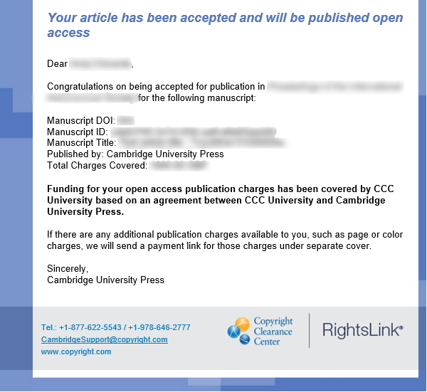
Confirmation
Notification sent to the corresponding author to confirm that the APC waiver/discount has been approved and applied, and that the article will be published OA.

Slide 13
Librarian Touch Points and Messaging
Messaging which may be received by your Agreement Manager administrator for the duration of your Transformative Agreement with Cambridge University Press
Message Received
“Welcome to Rightslink”
“One of your researchers has had a manuscript accepted for publication”
Trigger
Sent after you have been granted access to the Agreement Manager Institutional Portal for the first time
If automatic approvals are off, the institution gets notified that an accepted manuscript is eligible for their funding
Action Required
Follow the instructions and complete the reset password process to log into Agreement Manager
User invited to log in to Institutional Portal to review and act upon the request

Slide 14
Author Touch Points and Messaging
Message Received
“Manuscript decision”
(from CUP)
“Welcome email from CUP production”
(from CUP)
Trigger
Sent when an article has been accepted for publication
Sent after CUP production has updated the article record with the author publishing agreement
Action Required
“Your APC funding request has been approved/denied”
(from Rightslink)
If automatic approvals are on: immediately on auto approval of the funding by Rightslink. If automatic approvals are off: once the librarian has approved or denied the funding in Agreement Manager
This is the key decision point for the author to make their article open access. Author must complete their author publishing agreement and choose Open Access.
None required if the author has completed their author publishing agreement
None. Information only.

Slide 15
The author publishing journey
Rightslink OA Agreement Manager
Post sales support
Contact details

Slide 16
We work with Rightslink®-CCC to process article processing charges (APCs).
Institutions and authors participating in institutional Open Access agreements benefit from Rightslink®'s tool, OA Agreement Manager, which has been purpose-built to facilitate smoother financial transactions for authors and administrators.
This allows us to identify authors who are eligible for an APC discount/waiver and automatically apply a waiver, meaning a ‘touch free’ journey for the author.
OA Agreement Manager

Slide 17
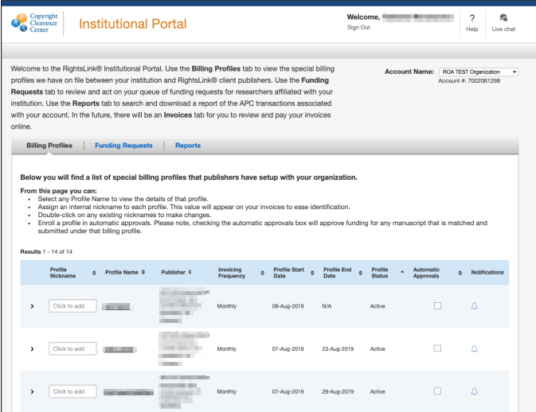
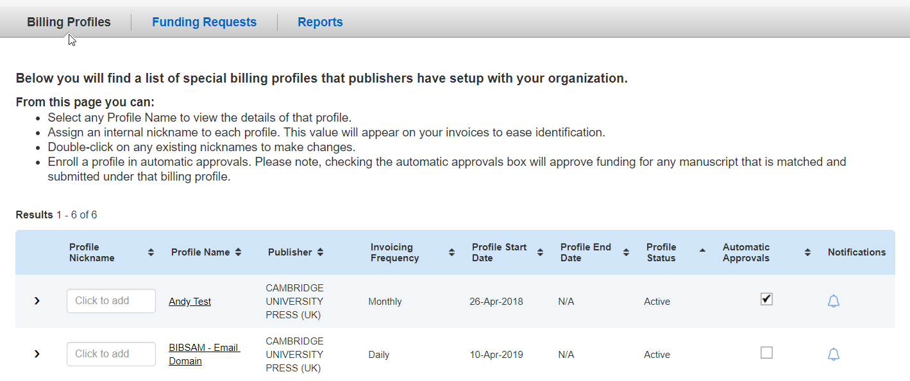
Institutional Portal
Once on-board, administrators will receive log-in details.
Login: https://apcfunding.copyright.com/
How to:
View and update your profile
Turn on automatic approvals
Set up alerts

Slide 18
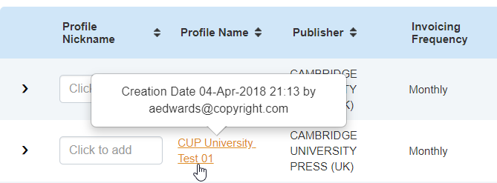
Updating your profile
To see details held on your billing profile click the Profile Name link.
You can edit your contact information within this space.
If you wish to change the email address that you use to log in to Agreement Manager, please get in touch with us.

Slide 19
Updating your profile (cont..)
You can also see information about your profile including the journals titles eligible under your deal, and the Institutional Identifiers we have associated with your account.

Slide 20
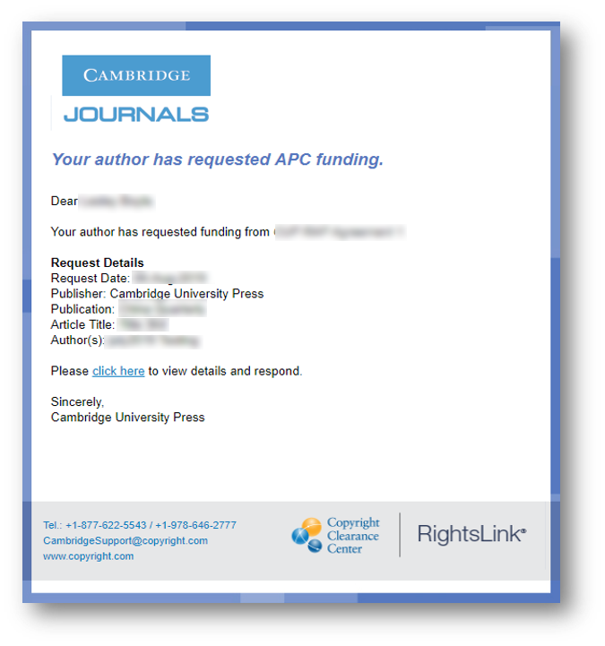
Turn On Automatic Approvals
Touch free functionality works with or without institution interaction.
Institutions can opt for articles to be approved automatically. We strongly recommend that you turn on automatic approvals for article publications by ticking the automatic approvals box.
We recommend this because:
No delay in article publication for the author.
Reduced administration.
Automatic approvals can be switched on or off at any time throughout the agreement.
Each year you will need to turn on automatic approvals again, as it will default to approvals being off.

Slide 21
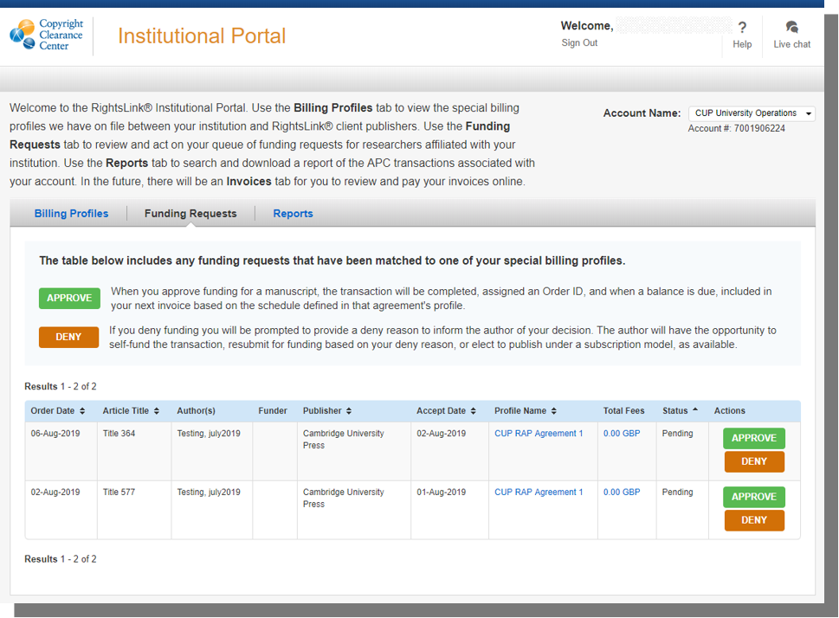
Approvals
If automatic approvals are turned off, the administrator will need to go into Agreement Manager to approve or deny the funding.

Slide 22
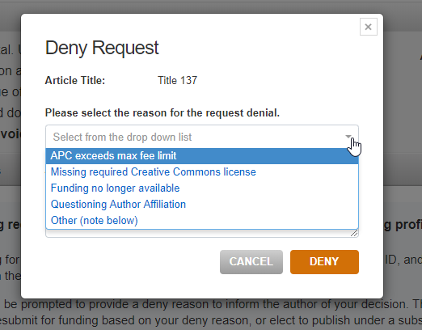
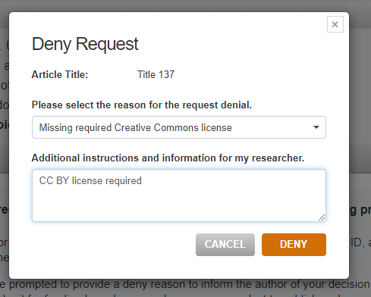
Denials
If denying, a reason for denial must be given. This information is sent to the author in a denial notification email.

Slide 23
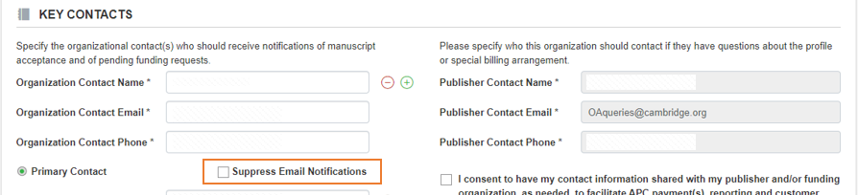
Notifications
Irrespective of the automatic approval status, administrators will still receive email notifications for funding requests.
These email notifications can be suppressed from within the institutional profile.

Slide 24
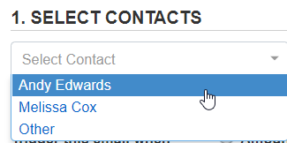
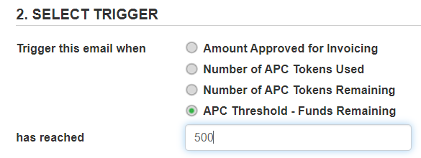
Notifications (cont..)
Remember to save!
Agreement Manager administrators can set up notifications based on spending amounts or APC token used, or tokens remaining.
Click the bell to enter the notification setup:
1. Select the contact from your organisation who you wish to receive the notification.
2. Set when they should be notified – either when APC tokens used/remaining, or when funds used/remaining (GBP) reach a certain threshold.
3. Remember to save!

Slide 25
The author publishing journey
Rightslink OA Agreement Manager
Post sales support
Contact details

Slide 26
Reporting
On a regular basis, you will be sent a report by Cambridge which includes data for both Open Access and Subscription-based articles published by corresponding authors at participating institutions.

Slide 27
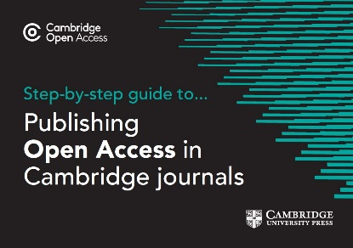
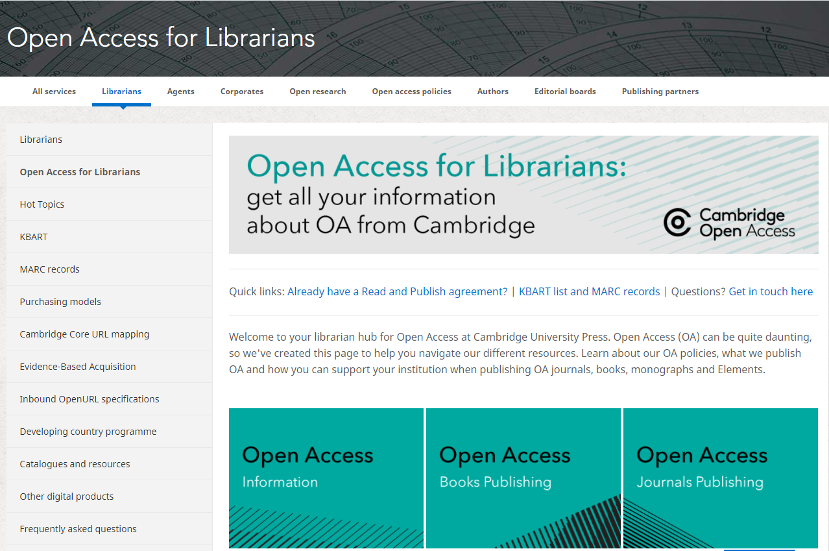
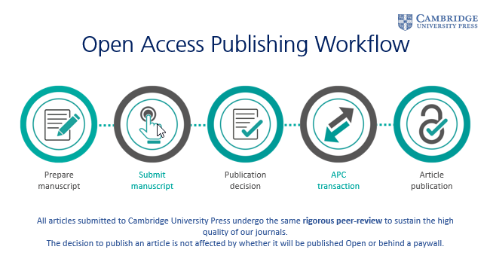
Resources
For authors
Guidance on publishing OA
Webinars and video resources
For you
OA Information
Read & Publish promotional resources
Rightslink Institution Resource Centre
Training
Regular sessions to support your understanding of the author workflow and how to use Agreement Manager
Training requests can be made via academictraining@cambridge.org

Slide 28
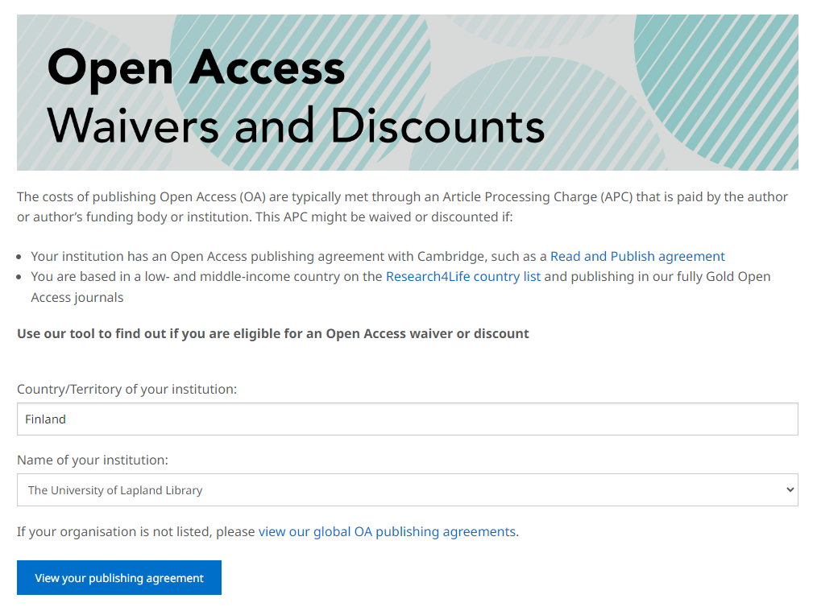
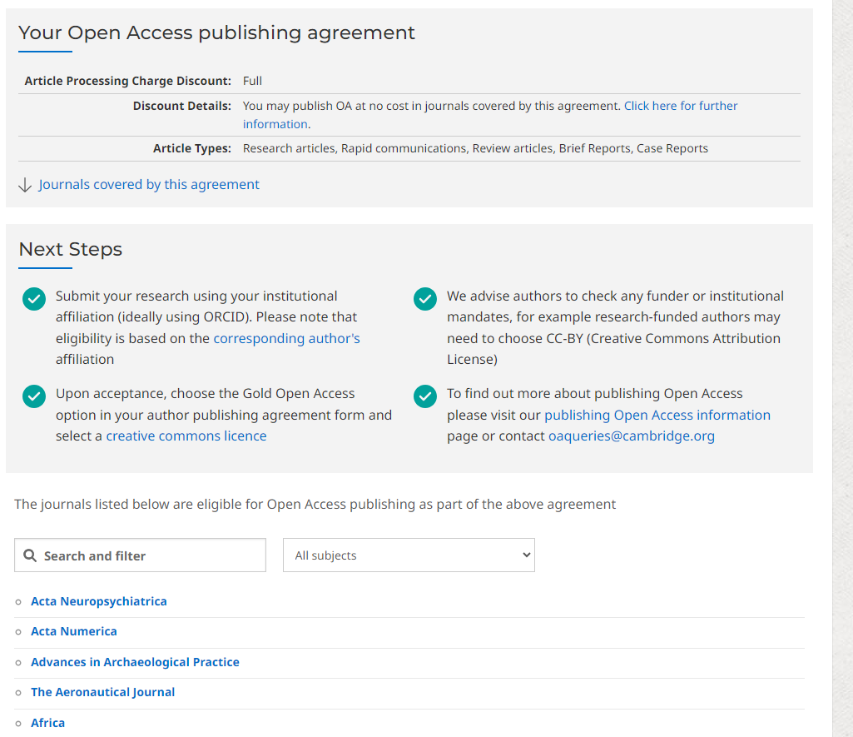
OA Waiver & Discount Tool
Allows authors to easily check their eligibility to publish under an Open Access publishing agreement, including:
APC discount available under agreement
Link to deal agreement page (for specific terms agreed)
Journals included in agreement
OA Waivers and Discount Tool

Slide 29
Top Tips
Contact details
Automatic approvals
Promote your agreement
Make sure we have your correct contact details
Reduce your administrative burden and optimise author experience
Make sure your authors are aware through your key channels

Slide 30
FAQs

Slide 31
How does Cambridge identify an author’s eligibility under an agreement?
Once an article is accepted for publication, the metadata is fed into our Production system, where the affiliation string is automatically assigned a ROR ID, which allows us to match the institution to a R&P agreement.
If an article has an R&P eligible ROR ID, we assess the article under the criteria relevant to the agreement (article type, journal package, term of agreement). This allows us to confidently identify authors who are eligible for an APC waiver or discount through an OA publishing agreement.
An author will enter their affiliation details into the Online Peer Review System (OPRS) when submitting their article. Details in the 'affiliation string' that are necessary to identify eligibility under R&P include institution and email domain. We rely on authors to enter their correct affiliation details and work on a system of trust.

Slide 32
A ROR ID is assigned to the article’s metadata before it is sent to Rightslink®.
The ROR assigned is based on the corresponding author’s institutional affiliation.
Institutions are not required to provide RORs as we take this information from the ROR database.
GRID ID now replaced by ROR
The Research Organization Registry (ROR) is a global, community-led registry of open persistent identifiers for research organizations. ROR makes it easy for anyone or any system to disambiguate institution names and connect research organizations to researchers and research outputs.

Slide 33
Questions and Answers

Slide 34
oaqueries@cambridge.org

